Slide 1

CURSOR CONTROL USING EYE MOVEMENTS

Slide 2
ABSTRACT:
Cursor control using eye movements is a novel human-computer interaction technique that allows users to manipulate the mouse pointer with their gaze and blink actions.
This project aims to develop a low-cost and user-friendly system that can track the eye movements of the user using a webcam and translate them into cursor movements and clicks.
The project uses Python as the programming language and OpenCV, MediaPipe and PyAutoGUI as the main libraries. The project employs facial landmark detection, eye aspect ratio calculation, head pose estimation and gaze direction estimation to determine the position and state of the user’s eyes.
The project demonstrates that cursor control using eye movements is a feasible and promising technique that can enhance the user experience and accessibility of computer applications.

Slide 3
SOFTWARE REQUIREMENTS:
PLATFORM – Python
OS – Windows 10, 64bit
PACKAGES – OpenCv, mediapipe, pyautogui
HARDWARE REQUIREMENTS:
PROCESSOR – x86 32-Bit CPU (Intel/AMD)
DISK SPACE – 5GB Above
RAM – 4GB
HARDWARE – Webcam

Slide 4



MODULES:-
Eye tracking module
Cursor movement module
Click detection module

Slide 5
Eye tracking module: This module is responsible for capturing the images of the user’s face and eyes using a webcam and detecting the facial landmarks and eye regions using OpenCV and MediaPipe libraries. This module also calculates the eye aspect ratio (EAR) to determine if the user is blinking or not.

Slide 6
Cursor movement module: This module is responsible for moving the cursor on the screen according to the gaze direction of the user using PyAutoGUI library. This module uses the screen coordinates from the gaze estimation module to control the mouse pointer position and speed.

Slide 7
Click detection module: This module is responsible for detecting the click actions of the user using PyAutoGUI library. This module uses the eye aspect ratio (EAR) from the eye tracking module to determine if the user is performing a single blink, a double blink or a long blink. This module also assigns different click actions to each blink type, such as left click, right click or drag and drop.

Slide 8
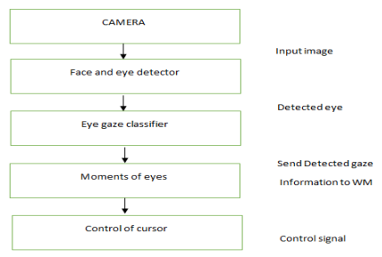
WORKFLOW:-

Slide 9
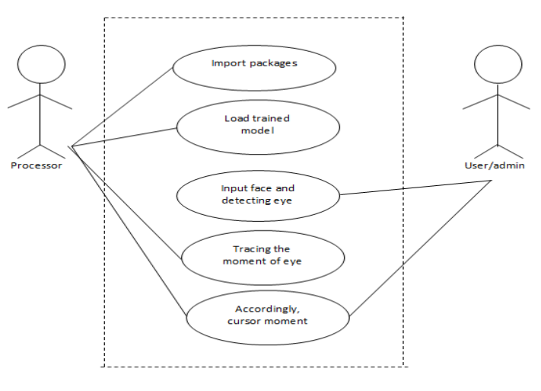
USECASE DIAGRAM:

Slide 10
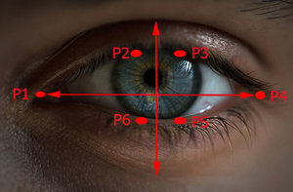
INPUT:-

Slide 11
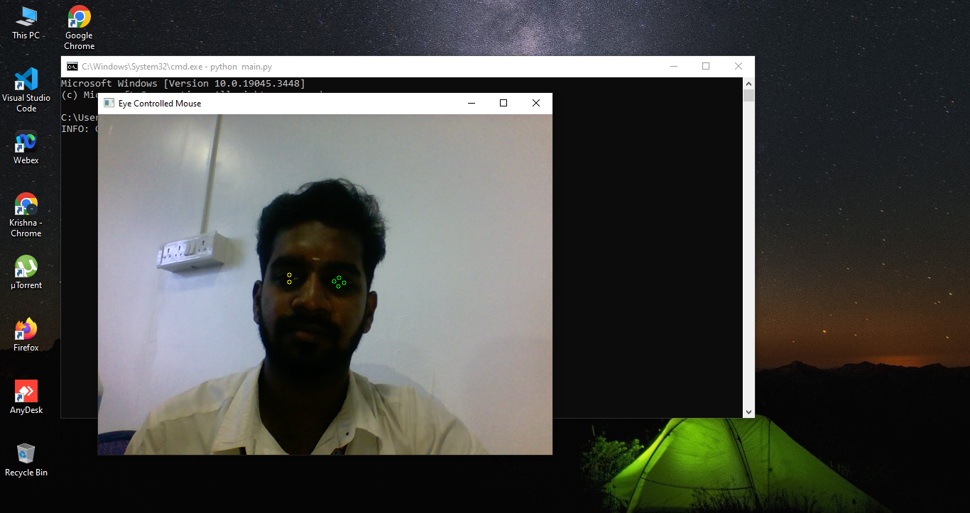
OUTPUT:

Slide 12
Thank You

